Slide 1
Introduction to Software Engineering & UML

Slide 2
01
Software Requirements Engineering (SRE)

Slide 3
SDLC cycle
Requriments
Design
01
02
Understand what the customer or user needs.
Translate requirements into a technical blueprint
Testing
Developing
06
03
Ensure the software meets requirements and is defect-free
Convert the design into executable code
05
Deployment
Maintance
04
Ensure the continued usability and performance of the software.
Make the system available to users.
This template has been created by Slidesgo

Slide 4
🧩 1. Software Requirements Engineering (SRE)
“What’s the most common cause of software project failure?” ❌ Poorly understood or changing requirements.
What happens if requirements are unclear?
Rework, cost overruns, unhappy customers.
Software Requirements Engineering (SRE) = the disciplined process of discovering, documenting, and maintaining a set of requirements for a software system.

Slide 5
⚙️ The Requirements Engineering Process
Elicitation
→
Specification
→
Validation
→
Management
gathering requirements
Documenting the gathered requirements
documented requirements are Correct
Right tools to manage
Each step helps ensure we build the right system, not just build it.

Slide 6
🔍 1. Requirements Elicitation
Definition:
The process of gathering requirements from stakeholders (clients, users, domain experts, etc.).
Key Challenges:
Users don’t always know what they want.
Conflicting needs from different stakeholders.
Requirements can change over time.

Slide 7
Techniques for Requirements Elicitation
Technique | Description | Example
Interviews | One-on-one discussion to extract user needs | Ask restaurant owner how online ordering works
Workshops / Focus Groups | Gather multiple stakeholders | Joint discussion on order flow
Observation / Ethnography | Watch users in their real environment | Observe hotel receptionist using booking software
Questionnaires / Surveys | Collect info from many users quickly | Collect feedback on desired mobile app features
Brainstorming | Generate new ideas | Team session to explore new payment methods
Prototyping | Show mockups to refine needs | Figma prototype of homepage

Slide 8
📄 2. Requirements Specification
Definition:
Documenting the gathered requirements in a clear, structured, and testable way.
Types:
Functional Requirements: what the system should do (features, behaviors).
Example: “The system shall send an email when a booking is confirmed.”
Non-Functional Requirements: how the system should perform.
Example: “The system shall respond within 2 seconds.”

Slide 9
📄 2. Requirements Specification
Software Requirements Categories
Requirements are mainly divided into two broad types:
A. Functional Requirements (FR)
Define what the system should do — its features, behaviors, or functions.
Examples:
The system shall allow users to log in using email and password.
The system shall send an OTP for account verification.
Representation:
Use cases, user stories, or feature lists.
💡 Tip: These are visible to users and directly related to system operations.

Slide 10
📄 2. Requirements Specification
B. Non-Functional Requirements (NFR)
Define how the system should perform — constraints, qualities, and attributes.
Categories of Non-Functional Requirements:
Type | Description | Example
Performance | Speed, response time | “System shall respond within 3 seconds.”
Security | Protection from unauthorized access | “System shall encrypt all passwords.”
Usability | Ease of use, accessibility | “Interface shall support both English and Arabic.”
Reliability | System stability and fault tolerance | “System uptime shall be 99.9%.”
Scalability | Ability to handle growth | “System shall support 10,000 concurrent users.”
Portability | Runs on different platforms | “App shall work on iOS and Android.”
Maintainability | Ease of updates/fixes | “Code shall follow modular architecture.”
Compliance | Meets legal or industry standards | “System shall comply with GDPR.”

Slide 11
Functional vs Non-Functional Comparaison Table
Feature | Functional | Non-Functional
Focus | What the system does | How the system performs
Example | “User can upload a profile picture” | “Upload should complete in <5 seconds”
User visibility | Directly visible | Often behind the scenes
Test type | Functional Testing | Performance, Security, Usability Testing

Slide 12
Functional vs Non-Functional Comparaison Table
“Functional requirements make software useful. Non-functional requirements make it usable.”

Slide 13
📄 2. Requirements Specification
Good Specification Qualities (SMART):
Specific
Measurable
Achievable
Relevant
Testable
Document Examples:
Software Requirements Specification (SRS)
User Stories in Agile
Use Case Diagrams (UML)

Slide 14
📄 2. Requirements Specification
Use the SMART principle:
Guideline | Description | Example
Specific | Clearly defines one functionality | “System shall allow users to upload one file at a time.”
Measurable | Has a success/failure condition | “Upload completes within 10 seconds.”
Achievable | Realistic to implement | “Supports up to 10,000 concurrent users.”
Relevant | Aligns with business goal | “Admin can view user reports for auditing.”
Testable | Can be verified by a test case | “System shall send an email upon successful registration.”

Slide 15
✅ 3. Requirements Validation
Definition:
Ensuring the documented requirements are:
Correct
Complete
Feasible
Consistent
Testable
🎯 Practical Tip: Ask the client to sign off or confirm requirements after validation to prevent later misunderstandings.
Validation Techniques:
Technique | Description
Reviews / Inspections | Walkthroughs by team members
Prototyping | Verify with user feedback
Test-case generation | Check testability of each requirement

Slide 16
“If you get the requirements wrong, everything that follows will be wrong too.” — Steve McConnell

Slide 17
4. Recognizing Requirements Tools (Industry Practice)
A. Why Tools Are Used
Centralize all requirements in one place.
Track changes and priorities.
Connect requirements → tasks → testing → deployment.
Enable collaboration between developers, testers, and clients.
Tool | Purpose | Key Features
Jira (Atlassian) | Enterprise-grade Agile/requirements tracking | Backlog, Epics, User Stories, Sprints, Workflow automation
Trello | Lightweight Kanban board for tasks | Simple drag-and-drop boards, checklists, labels
Azure DevOps | Requirements + Dev + Test + CI/CD | Requirements linked with code and testing
Notion | All-in-one workspace | Requirements pages, team docs, and database

Slide 18
Case Study: Requirements Process Hotel Management Case Study

Slide 19
02
UML Overview & Modeling Concepts

Slide 20
🔹 What is Modeling?
Definition:
Modeling is the process of creating a simplified representation (model) of a system to understand, design, or communicate how it works.
It’s like drawing a blueprint before constructing a building.
Analogy:
Architects make blueprints before construction.
Software engineers make models before coding.

Slide 21
Purpose of Modeling
Goal | Explanation
Understand the system | Visualize complex systems simply
Communicate with stakeholders | Helps non-technical people see what’s being built
Analyze and refine | Identify problems early (before coding)
Guide implementation | Acts as a roadmap for developers
Document the design | Useful for maintenance and updates later

Slide 22
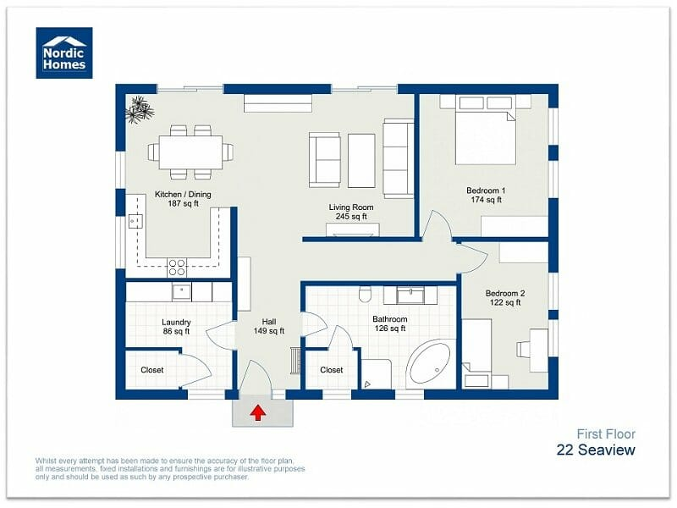
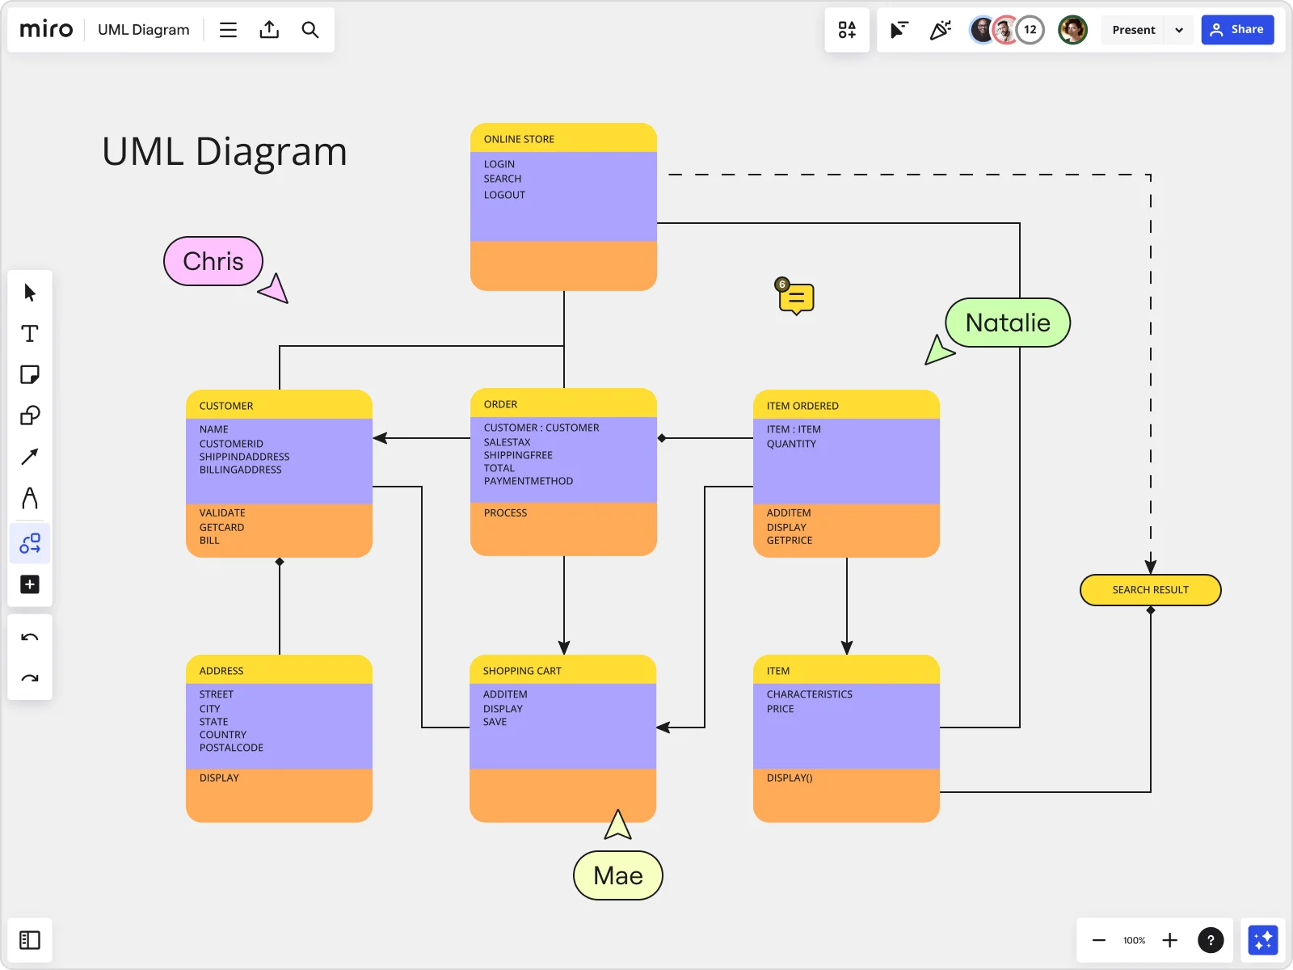
🔹 What is a Software Model?
Definition:
A software model is a structured representation of a software system, showing its components, relationships, and behaviors.
It’s a blueprint of the software before actual development.

Slide 23
Types of Software Models
Model Type | Focus | Example Diagram
Structural Models | What the system is (components, classes, architecture) | Class Diagram, Component Diagram
Behavioral Models | What the system does (interactions, workflows) | Use Case, Sequence, Activity Diagrams
Physical Models | How it’s deployed or implemented | Deployment Diagram
💡 Together, these models provide a full picture of the system.

Slide 24
1. What is UML?
Definition:
UML (Unified Modeling Language) is a visual language for modeling, designing, and documenting software systems.
Purpose:
To visualize the structure and behavior of a system before building it.
To communicate ideas clearly between developers, designers, and stakeholders.
To standardize system representation — everyone uses the same symbols and rules.
To bridge requirements → design → implementation.
🧩 Key Point: UML is not a programming language, but a communication language understood by developers, designers, and stakeholders.

Slide 25
2. Why UML Is Important
Purpose | Benefit
Visual Communication | Easier to explain system logic to non-technical stakeholders
Requirement Clarification | Helps identify missing or conflicting requirements
Design Planning | Supports system structure before coding
Documentation | Keeps project understandable and maintainable
Team Collaboration | Ensures everyone has a shared understanding of the system
Analogy:
Just like an architect draws a blueprint before building a house, a software engineer creates UML diagrams before coding a system.

Slide 26
SDLC cycle
Requriments
Design
01
02
Understand what the customer or user needs.
Translate requirements into a technical blueprint
Developing
Testing
06
03
Convert the design into executable code
Ensure the software meets requirements and is defect-free
05
Deployment
Maintance
04
Ensure the continued usability and performance of the software.
Make the system available to users.
This template has been created by Slidesgo

Slide 27
Where UML Fits in SDLC
SDLC Phase | UML Contribution
Requirements | Use Case Diagrams
Design | Class, Sequence, and Activity Diagrams
Implementation | Component and Deployment Diagrams
Testing | State and Interaction Diagrams

Slide 28
🧱 UML Diagram Types Overview
UML has 14 official diagram types, grouped into Structural and Behavioral views.
A. Structural Diagrams
(Show how the system is built — its static structure)
B. Behavioral Diagrams
(Show how the system behaves or interacts over time)

Slide 29
🧱 2. UML Diagram Types Overview
UML has 14 official diagram types, grouped into Structural and Behavioral views.
UML Type | Key Purpose | Common Use
Use Case | Show system interactions | Requirements stage
Class | Show structure of system | Design stage
Sequence | Show message flow | Implementation
Activity | Show process/workflow | Design & Testing

Slide 30
Hands-On UML Modeling

Slide 31
1. What is a Class Diagram?
Definition:
A Class Diagram is a UML diagram that shows the static structure of a system — its classes, attributes, methods, and relationships.
It’s the blueprint of the system’s object-oriented design.
Analogy: the Class Diagram shows how the system is built internally.

Slide 32
⚙️ Steps to Create a Class Diagram
Step | Description | Example
1. Identify main classes | Nouns in requirements often become classes | Customer, Product, Order
2. Add attributes | Data each class needs to store | name, price, orderDate
3. Add methods | Actions each class performs | login(), calculateTotal()
4. Define relationships | How classes are connected | Customer places Order
5. Add multiplicity | Show one-to-many or many-to-many | 1 Customer → many Orders
6. Add inheritance | Show “is-a” relationships | Admin → User

Slide 33
Class Diagram Basic Structure (annotations)
A class is represented as a rectangle divided into three parts:
Section | Meaning
Top | Class name
Middle | Attributes (fields or variables)
Bottom | Operations / Methods (functions)
Concept
Employee
type
Attributes
-Float salary
+int getAge()
+Price getSalary()
Signature
Operations

Slide 34
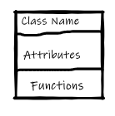

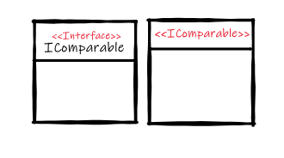
Class Diagram Basic Structure (annotations)
A class represent A class encapsulates state (attributes) and behavior (operations).
UML suggests that the class name:
Start with a capital letter
Be centered in the top compartment
Be written in a boldface font
Be written in italics if the class is abstract.
You can hide any compartment of the class if that increases the readability of your diagram.
You may add compartments to a class to show additional information, such as exceptions or events.
11/21/2025
34

Slide 35
Visibility Symbols (Access Modifiers)
Symbol | Meaning | Example
+ | Public – accessible by all classes | +name: String
- | Private – accessible only within the class | -balance: double
# | Protected – accessible within the class and subclasses | #age: int
~ | Package – accessible within the same package | ~address: String
Tip: These symbols mirror the access modifiers you use in OOP languages like Java, C++, or Python.

Slide 36
Attributes Notation
Format: visibility name: type = defaultValue {Constrain}
Static variables: underlined
Const variables: Uppercase
Example: +price: double = 0.0 -quantity: int
Meaning: A public attribute named price of type double with default value 0.0.

Slide 37
Methods / Operations Notation
Format: visibility name(parameterList): returnType {operation constrains}
-firstLetterSmallerCase
-static functions: underlined
-functions that do not return a value could be void or an empty return type
Example: +getPrice(): double
+setPrice(p: double): void
Window
+ GetSize() : Rectangle
+ SetSize(name : string) : void
+ GetComponents() : Component [0..*]
# Paint() : void

Slide 38
Relationships Between Classes
In class diagrams, relationships between classes describe how classes are connected or interact with each other within a system.
🧩 1. Association
Represents a general connection between classes.
Shown as a solid line.
Department
Employee
Enumeration getEmployees()
float getSalary(emp)
*
*
+ salary:float
Department contains list of employee employee can work in any department

Slide 39
Relationships Between Classes
Multiplicity (Cardinality)
Symbol | Meaning
1 | Exactly one
0..1 | Zero or one
0..* | Zero or many
1..* | One or many

Slide 40

Relationships Between Classes
🧩 2. Aggregation (Has-a Relationship)
Represented by an empty diamond (◇) at the whole side.
The part can exist independently.
Department ◇--- Employee
Meaning:
A department has employees, but employees can exist without the department.

Slide 41

Relationships Between Classes
🧩 3. Composition (Strong Has-a Relationship)
Represented by a filled diamond (◆) at the whole side.
The part cannot exist without the whole.
House ◆--- Room
Meaning: A room cannot exist without a house.

Slide 42
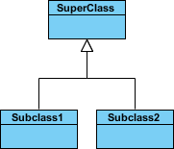
Relationships Between Classes
🧩 4. Inheritance / Generalization Represented by a solid line with an empty arrowhead (△) from subclass to superclass.
Person ◁── Student
Meaning: Student is-a Person.

Slide 43
Relationships Between Classes
🧩 5. Dependency
Represented by a dashed line with an arrow.Indicates that one class depends on another for some function (e.g., uses it temporarily).
Order -----------------> PaymentService
Meaning: Order depends on PaymentService to process payments.

Slide 44
Practice It Case Study

Slide 45
When to Use a UML Class Diagram
During the design of the architecture of the system
It does not show how things change over time, but rather how the system is organized.
The customer and end users are often not interested in class diagrams. They usually focus more on system functionality.

Slide 46
When to Use a UML Class Diagram
1. During the Design Phase of the SDLC
2. When You Need to Model the System’s Structure
3. When Designing Object-Oriented Systems
4. When Communicating Between Teams

Slide 47
2. What is a Use Case Diagram?
Definition
A Use Case Diagram shows how users (actors) interact with a system to achieve specific goals (use cases).
It represents the functional requirements of a system — what the system should do, not how it does it.
Use cases specify the expected behavior (what), and not the exact method of making it happen (how)

Slide 48
2. What is a Use Case Diagram?
A use case diagram is usually simple. It does not show the details of the use cases:
It only summarizes some of the relationships between use cases, actors, and systems.
It does not show the order in which steps are performed to achieve the goals of each use case.

Slide 49
🎭 2. Case Diagram annotations
Element | Symbol | Meaning
Actor | 👤 Stick figure | User or external system interacting with the system
Use Case | ⭕ Oval | Function or goal performed by the system
System Boundary | ▭ Rectangle | Defines the scope of the system
Relationships | Lines/arrows | Show how actors connect to use cases

Slide 50
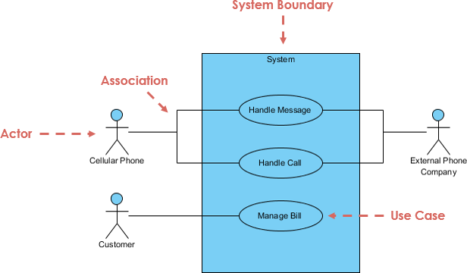
🎭 2. Key Elements

Slide 51
Actor
Someone interacts with use case (system function).
Named by noun.
Actor plays a role in the business
Can be a human, another system, or hardware.
For example:
A prof. can be an instructor and also a researcher
plays 2 roles with two systems
Actor triggers use case(s).
Actor has a responsibility toward the system (inputs), and Actor has expectations from the system (outputs).

Slide 52

Use Case
Each use case represents a single goal or system function.
System function (process - automated or manual)
Named using verb + noun format.
Each Actor must be linked to a use case, while some use cases may not be linked to actors.
✅ Examples: “Login”, “Place Order”, “Make Payment”
❌ Avoid vague names like “System Operation”.

Slide 53
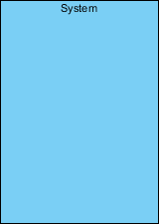
Boundary of system
The system boundary is potentially the entire system as defined in the requirements document.
For large and complex systems, each module may be the system boundary.
For example, for a system for an organization, each of the modules, such as personnel, payroll, accounting, etc.
can form a system boundary for use cases specific to each of these business functions.

Slide 54
⚙️ Steps to Create a Use Case Diagram
Step | Description | Example
1. Identify actors | Who uses or interacts with the system? | Customer, Admin, Payment System
2. Identify main use cases | What functions does each actor perform? | Login, Search Products, Place Order
3. Define system boundary | Draw a box for the system itself | “Online Shopping System”
4. Connect actors to use cases | Draw association lines | Customer → Place Order
5. Add relationships | Use “include”, “extend” where needed | “Checkout” includes “Payment”

Slide 55

🔗 4. Relationships Between Use Cases
A relationship between two use cases is basically modeling the dependency between the two use cases. The reuse of an existing use case by using different types of relationships reduces the overall effort required in developing a system
Association Link illustrates a set of use cases for a system, i.e. the actors and the relationships between the actors and use cases

Slide 56
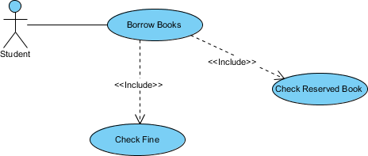
🔗 4. Relationships Between Use Cases
Include Relationship A common function always performed adds additional functionality not specified in the base use case. The <<Include>> relationship is used to include common behavior from an included use case into a base use case in order to support the reuse of common behavior

Slide 57

🔗 4. Relationships Between Use Cases
Extend Relationship
Optional or conditional function The extended relationships are important because they show optional functionality or system behavior. The <<extend>> relationship is used to include optional behavior from an extending use case in an extended use case.

Slide 58
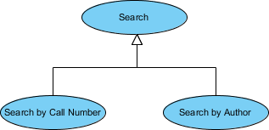
🔗 4. Relationships Between Use Cases
Generalization (Inheritance)
One actor or use case is a specialized version of another
A generalization relationship means that a child use case inherits the behavior and meaning of the parent use case. The child may add or override the behavior of the parentA generalization relationship means that a child use case inherits the behavior and meaning of the parent use case. The child may add or override the behavior of the parent

Slide 59
Use Case Diagram Examples & Case Study

Slide 60
3. What is an Activity Diagram?
Definition
An Activity Diagram is a UML diagram that shows the flow of activities (actions, decisions, and parallel processes) in a system or business process.
It focuses on how work moves from one activity(UseCase) to another.
Purpose
To visualize business workflows.
To understand logic before implementation.
To identify decision points and parallel tasks.
To clarify requirements for developers and testers

Slide 61

Key Elements
Action A task to be performed
Control Flow Shows the sequence of execution
Control Flow Portrays the beginning of a set of actions or activities

Slide 62


Key Elements
Activity Final Node Stop all control flows and object flows in an activity (or action)
Decision Node Represent a test condition to ensure that the control flow or object flow only goes down one path
Merge Node Bring back together different decision paths that were created using a decision-node.

Slide 63


2. Key Elements
Fork Node Split behavior into a set of parallel or concurrent flows of activities (or actions)
Join Node Bring back together a set of parallel or concurrent flows of activities (or actions).

Slide 64
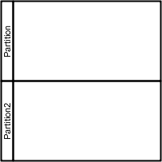
2. Key Elements
Swimlane and Partition
A way to group activities performed by the same actor on an activity diagram or to group activities in a single thread

Slide 65
When to Use It?
During requirements analysis → to model business processes.
During design → to show how operations or methods work.
Often based on a Use Case (each major use case can have one activity diagram).

Slide 66
Activity Diagram Examples & Case Study

Slide 67
Case Study: For the Requirements, we have collected that we need to make a different diagram for 3 of the requirements

Slide 68
Thanks
Do you have any questions?
Please keep this slide for attribution

Slide 69
Resources
Images and some examples from Visual Paradigm &

